Slide 1

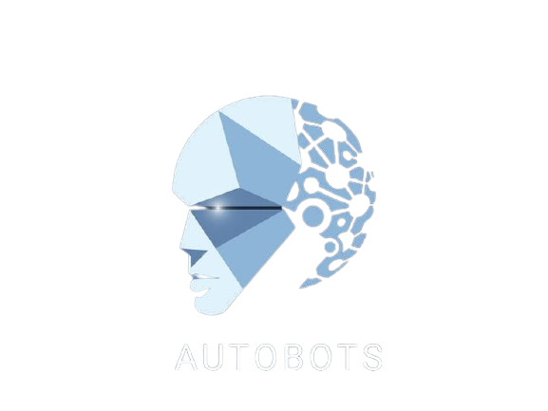

Slide 2
The Birth of Innovation comes from Madness

Slide 3

The Fear of Failure blinds us from the glimpse of the Future.

Slide 4


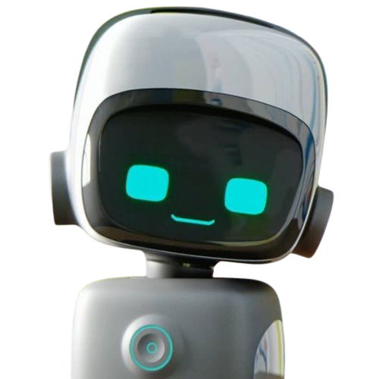
TABLE OF CONTENTS
EXECUTIVE SUMMARY
MARKET ANALYSIS
COMPANY SUMMARY
TECHNOLOGY AND RESEARCH
PRODUCT & SERVICES
FINANCIAL PLAN

Slide 5
Objectives
EXECUTIVE SUMMARY
Strategy
Spread of science and culture
Consistency in Research and Development
Technology Transfer and Training
Industrial cooperation
Military & Security Robots
AI Humanoid Robots.
Business Roadmap into military and defense services.

Slide 6

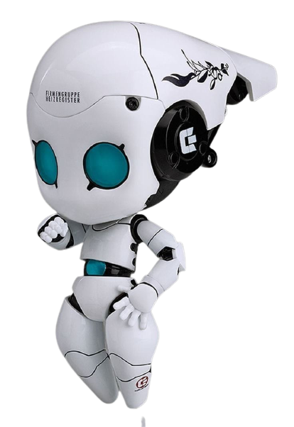
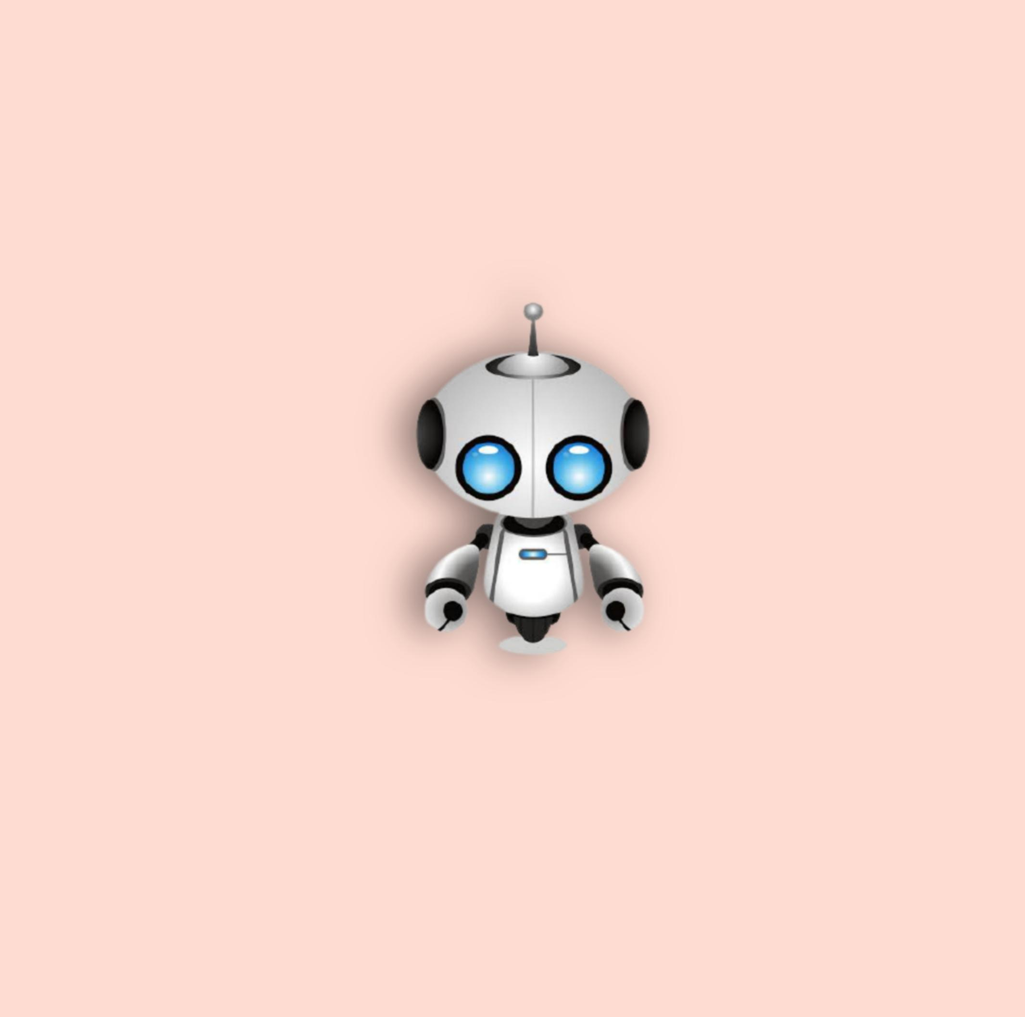
MISSION
Our Prime Target is to Develop Intelligent Service Robot such as Military, Security accumulated with Advanced and Strong technology.

Slide 7
What our company do
Create
Improve
Nanorobotics is an emerging technology field creating machines or robots whose components are at or near the scale of a nanometer and our company give 100% to improve this
Robots can be guided by an external control device or the control may be embedded within.
Autobots
Solve
Connect

Slide 8

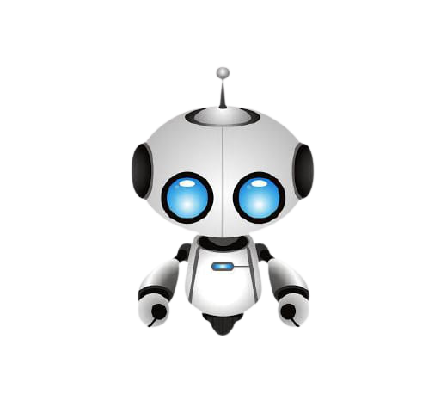
COMPANY SUMMARY
PROFILE
FUTURE

Slide 9


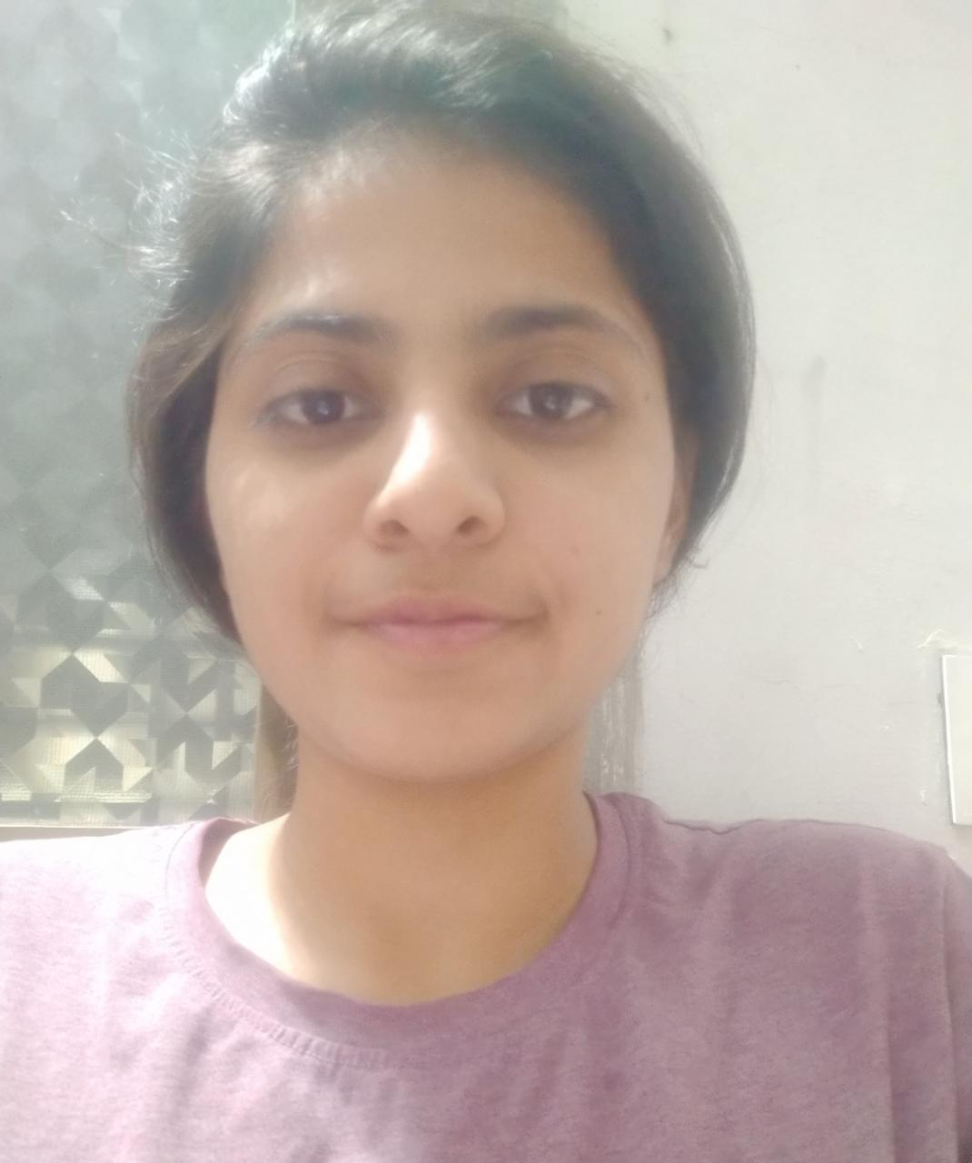
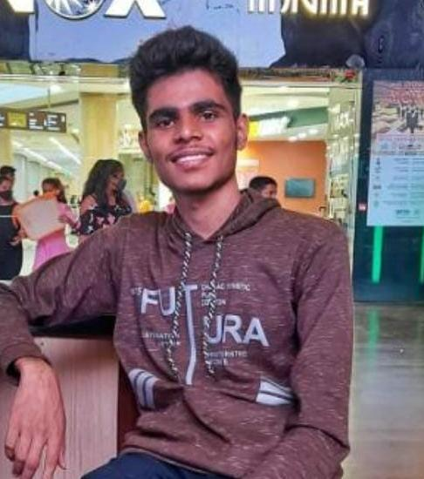







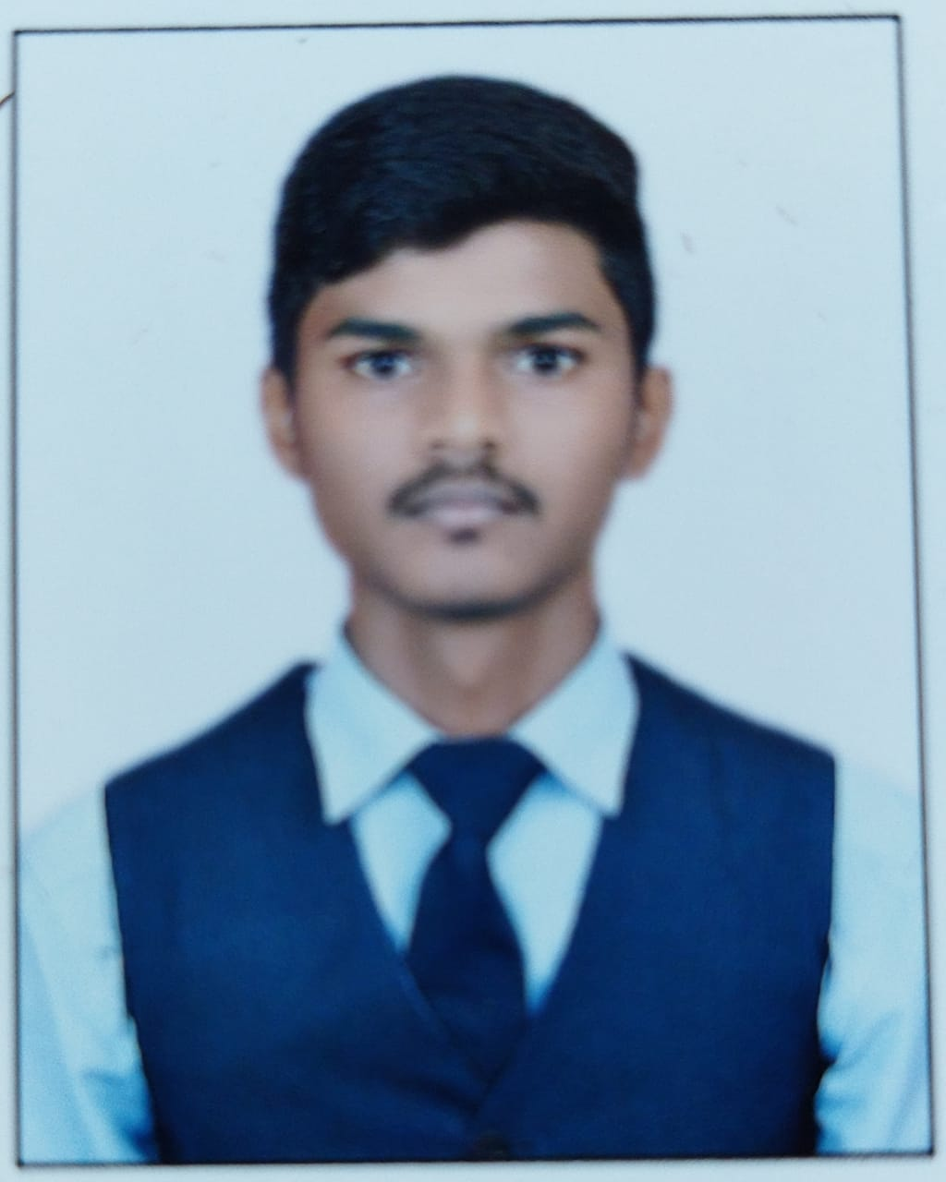

Our Team - Profile
IRFAN SHAIKH
NISHA KANGANE
HARSHAVARDHAN REDDY
RASHMI YADAV
VAIBHAV SHIGVAN
SIMRAN KHAN
AJAY CHOUGULE
NANDINI RAJAN

Slide 10

Future Goals
2021
2025
2029
2033
2050
Established our company
Going to Develop AUTOBOTS on Industrial Level
Plan to Create Humaniod Autobots
Outer Space Autobots
“Sic Mundus Creatus Est”
.

Slide 11
USA
INDIA
100
120
Rank 1
Rank 3
In ROBOTIC tech without Regenbot tech
With Regenbot tech (NANITES)
And the super power nation

Slide 12

Products and Services
NANITES
Nanites are the basic regenerative cell of the Alphabots and Humanoid
COMRADEBOTS
ALPHABOTS
COMRADEBOTS are the main bots which our company will make on a large scale and supply it to the world
ALVARO & IZABEL

Slide 13

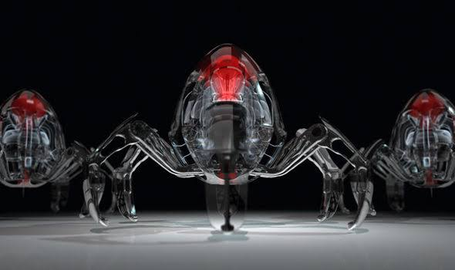
NANITES

Slide 14
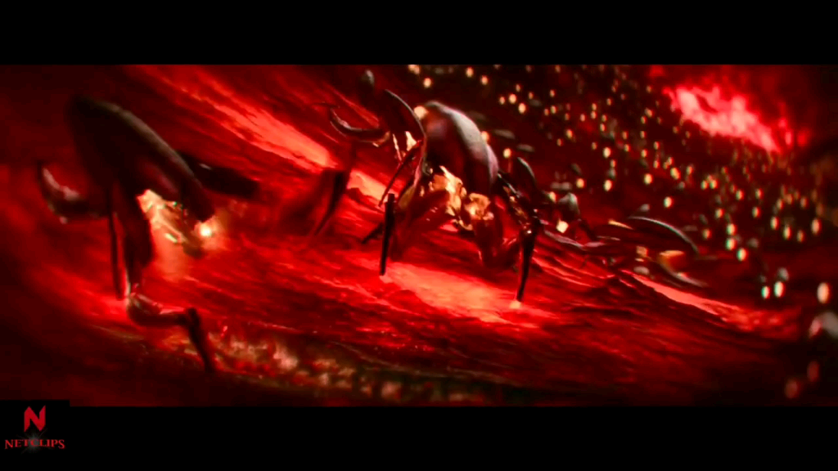

Slide 15
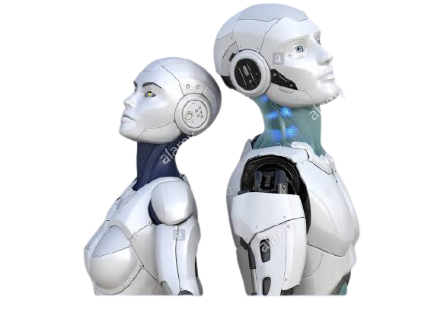
ALPHABOTS

Slide 16
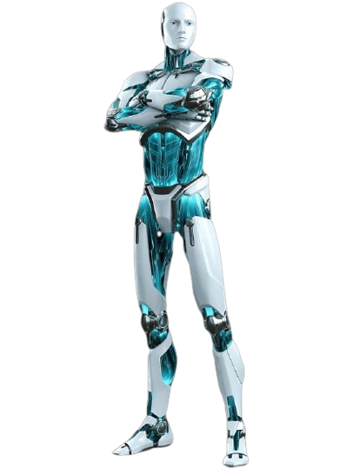
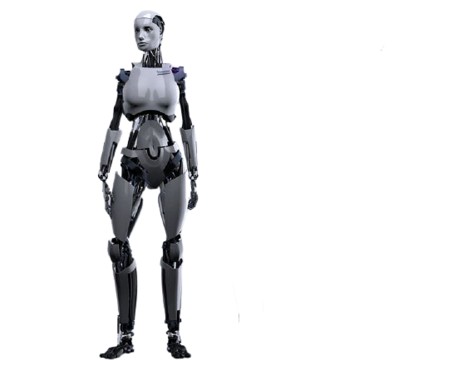
FEATURES
STRONGER AND POWERFUL ROBOT
REGENERATIVE
ADVANCED THAN THE HUMAN MIND
ALVARO
IZABEL

Slide 17
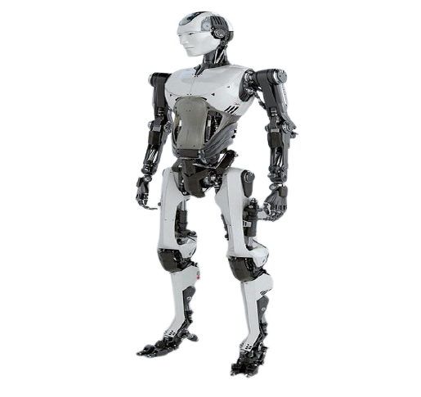
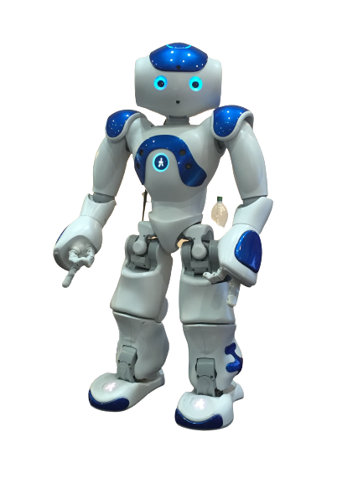
COMRADEBOTS
FEATURES
STRONGER AND POWERFUL THAN HUMAN MIND
75 % REGENERATIVE
A17
A69
A04

Slide 18
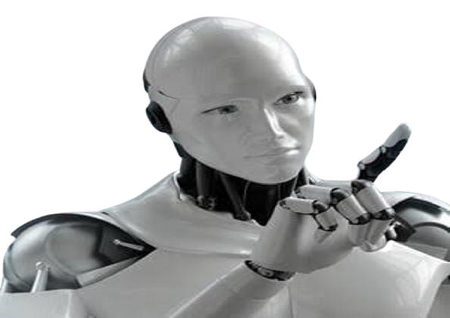
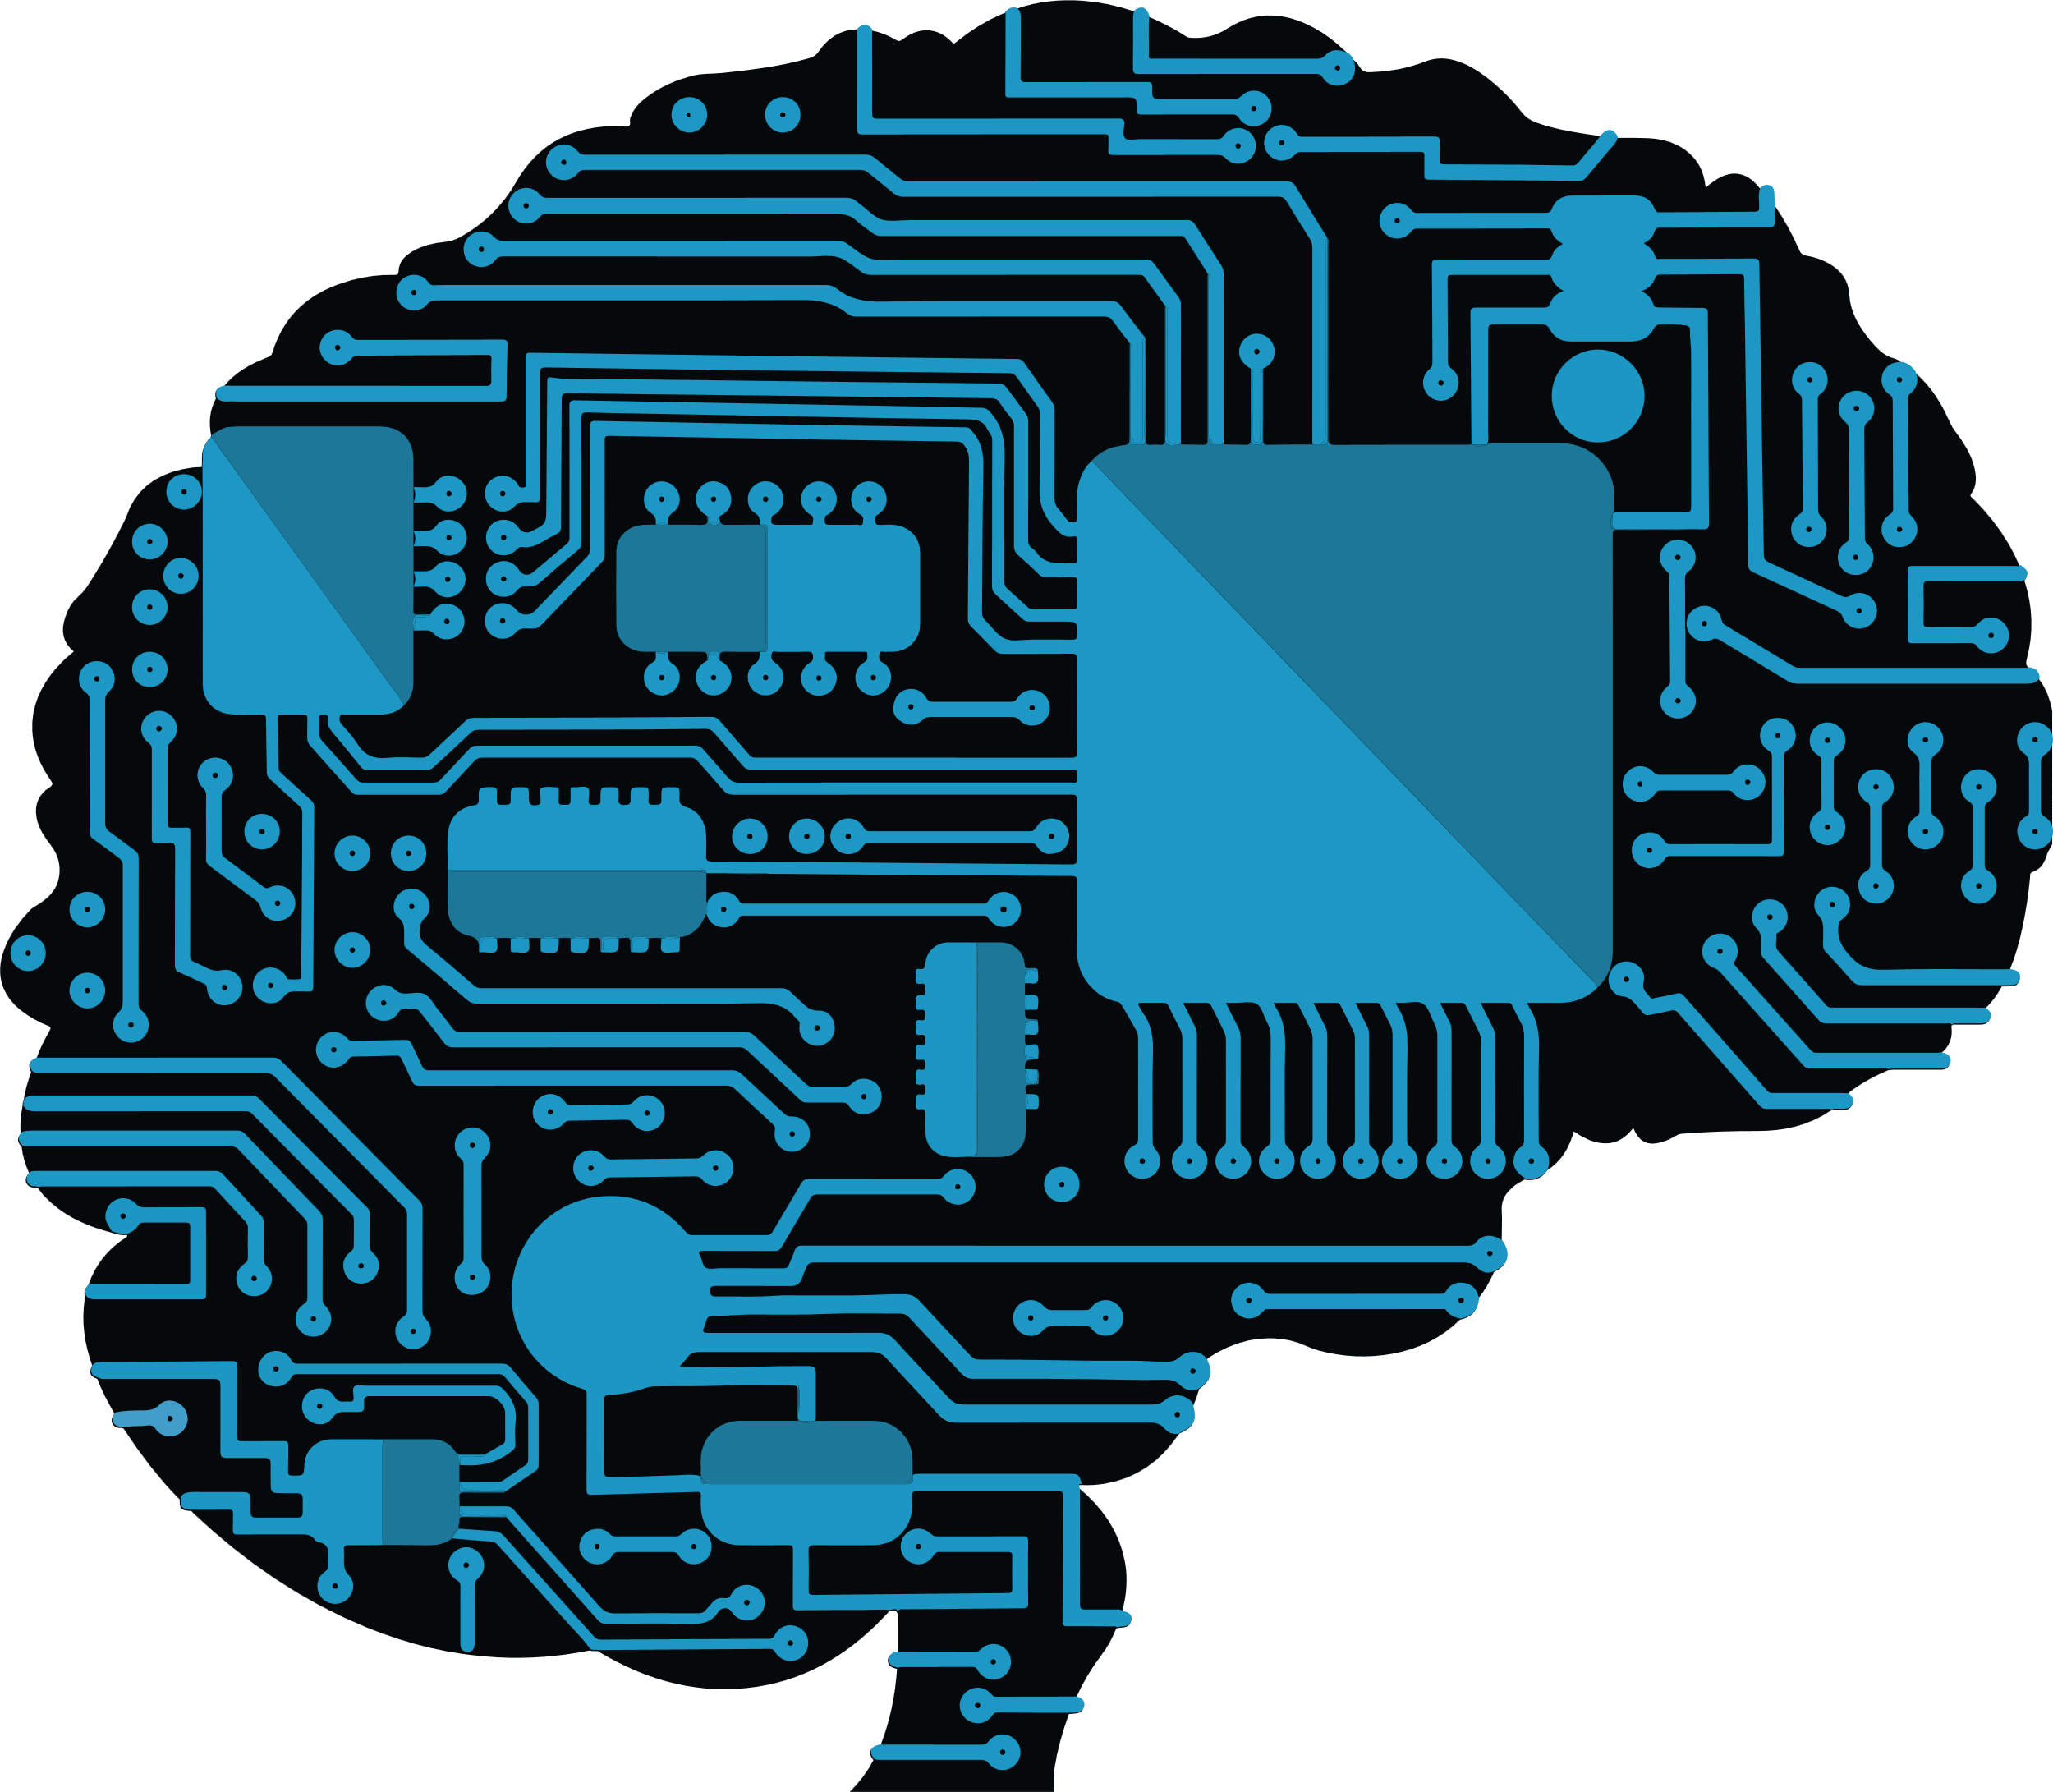
Humanoids
Humanoids are super soldiers that we are planning to initiate a work on it if the government of India gives a green sheet to our initiative If we got a check on it so we will make the injured army soldiers by their permission turn them into half human and half autobots and serve the nation on time the world.

Slide 20

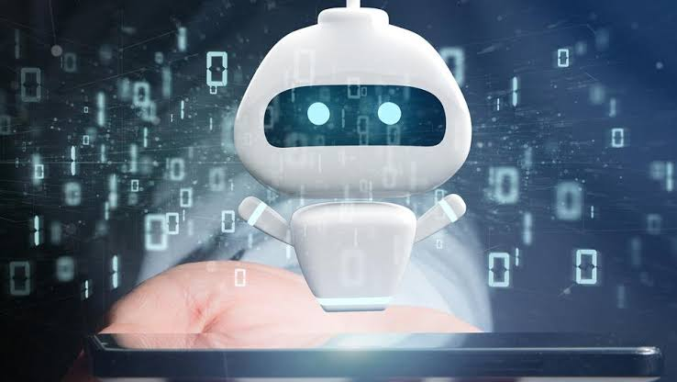
MARKET ANALYSIS
WORLD MARKET
ROBOT INDUSTRY TREND
MAJOR ROBOTICS COMPANY
MARKETING PLAN

Slide 21
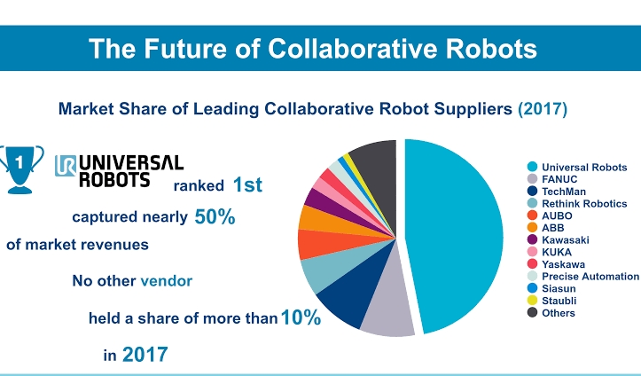
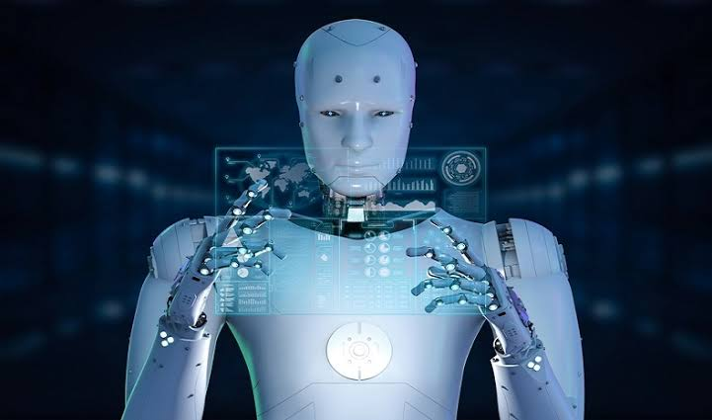
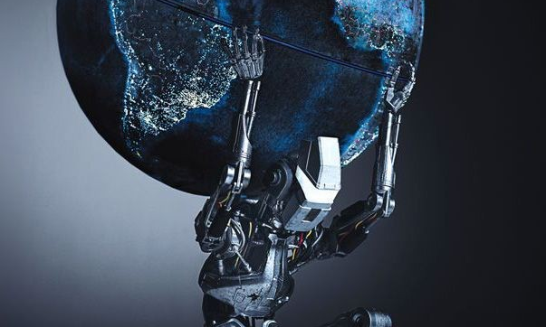
WORLD MARKET
The Robots will soon be the hot topic around the world from our Regenerative technology the world of robotics will reach to great heights and change the world.
Robot Industry

Slide 22
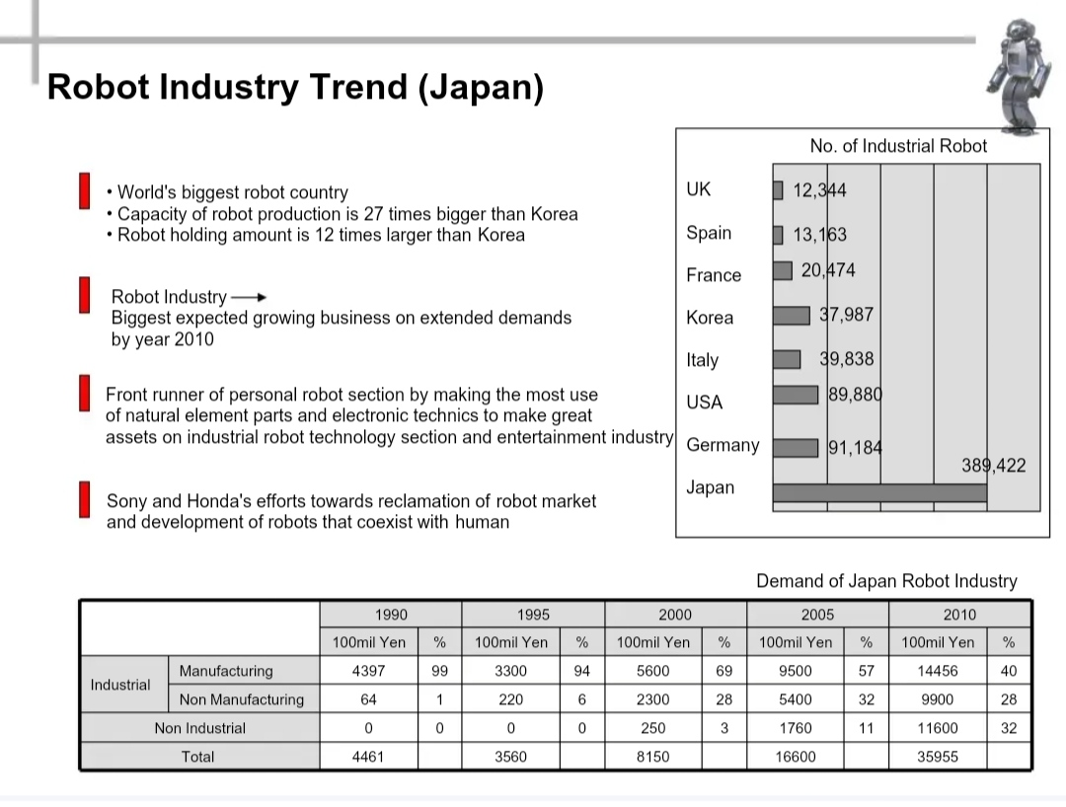
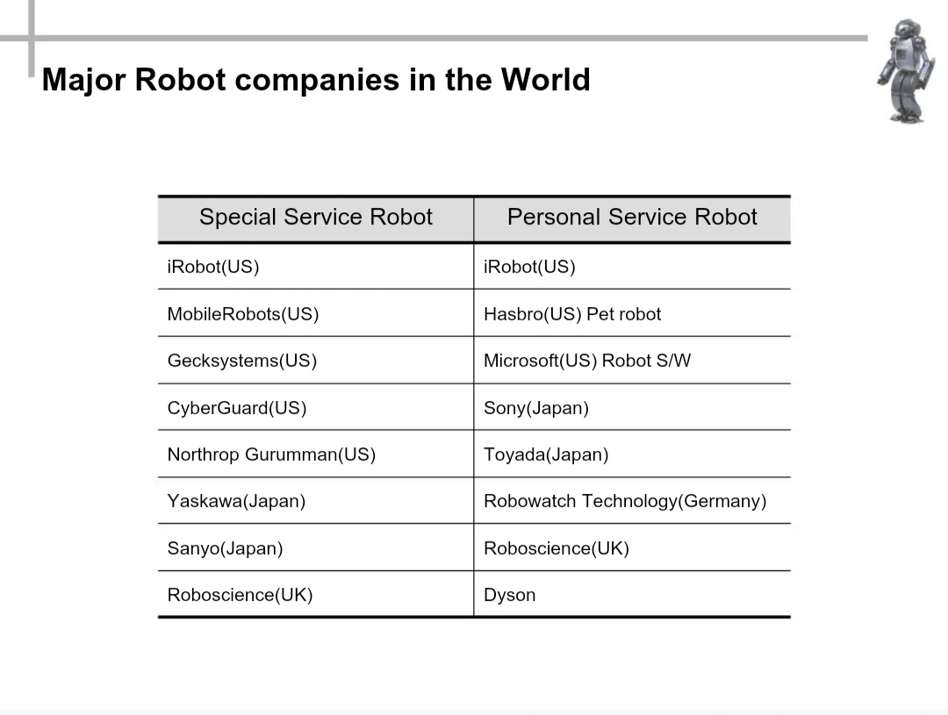
Marketing Analytics

Slide 23
MARKETING PLAN
INDIA’S ROBOTIC MARKET
FANUC is one of the largest industrial robot manufacturers with 200,000 installations worldwide. They are the leaders in India with over 4700 industrial robot installations. They have a large network of the sales team in PAN India and have their Advanced Technology Centres at Gurgaon, Pune, and Bangalore
India too saw a marginal decrease in the number of new installations in 2019 compared to 4,771 in 2018. In fact, in 2018, sales of industrial robots in India “reached a new record of 4,771 new units reporting an increase of 39% from the previous year (2017: 3,412 units),” according to separate data from IFR
INDIA’S ROBOTIC MARKET WITH AUTOBOTS
By the end of the year 2023 India will soon become one of the best in terms of Robotic Market all around the globe. AUTOBOTS regentech Nanites will soon make changes in growth of our nation and we will become a super power all over the globe The technology we have is the most unique cause we have a vision to get prepare for the threat that are not known to th world. If such happens we are prepared with our Autobots and ready to protect our world and our people. We are Waiting.

Slide 24

TECHNOLOGY AND RESEARCH
PROCESSOR
SENSORS ,
MOTORS
INTELLIGENCE
AUTOBOTS
TECHNOLOGY
CORE AUTOBOTS TECHNOLOGY
SYSTEM INTEGRATION
AND NEURAL SCHEME
NANITES
INTERFACE OF HUMAN AND AUTOBOTS

Slide 25
SWOT Analysis
Strengthen
World level IT Infrastructure
Nanites
Weakness
Weakness of captial and reliability of technology
S
W
Increase of world robot market
Opportunity
Advance country avoid technology transfer
Threaten
O
T

Slide 26

FINANCIAL PLAN
INVESTMENT PLAN
PROFIT AND LOSS
Taking Stock of Expenses
The Income Statement
The Cash Flow Projection
The Balance Sheet
(Assets = Liabilities + Equity)

Slide 27
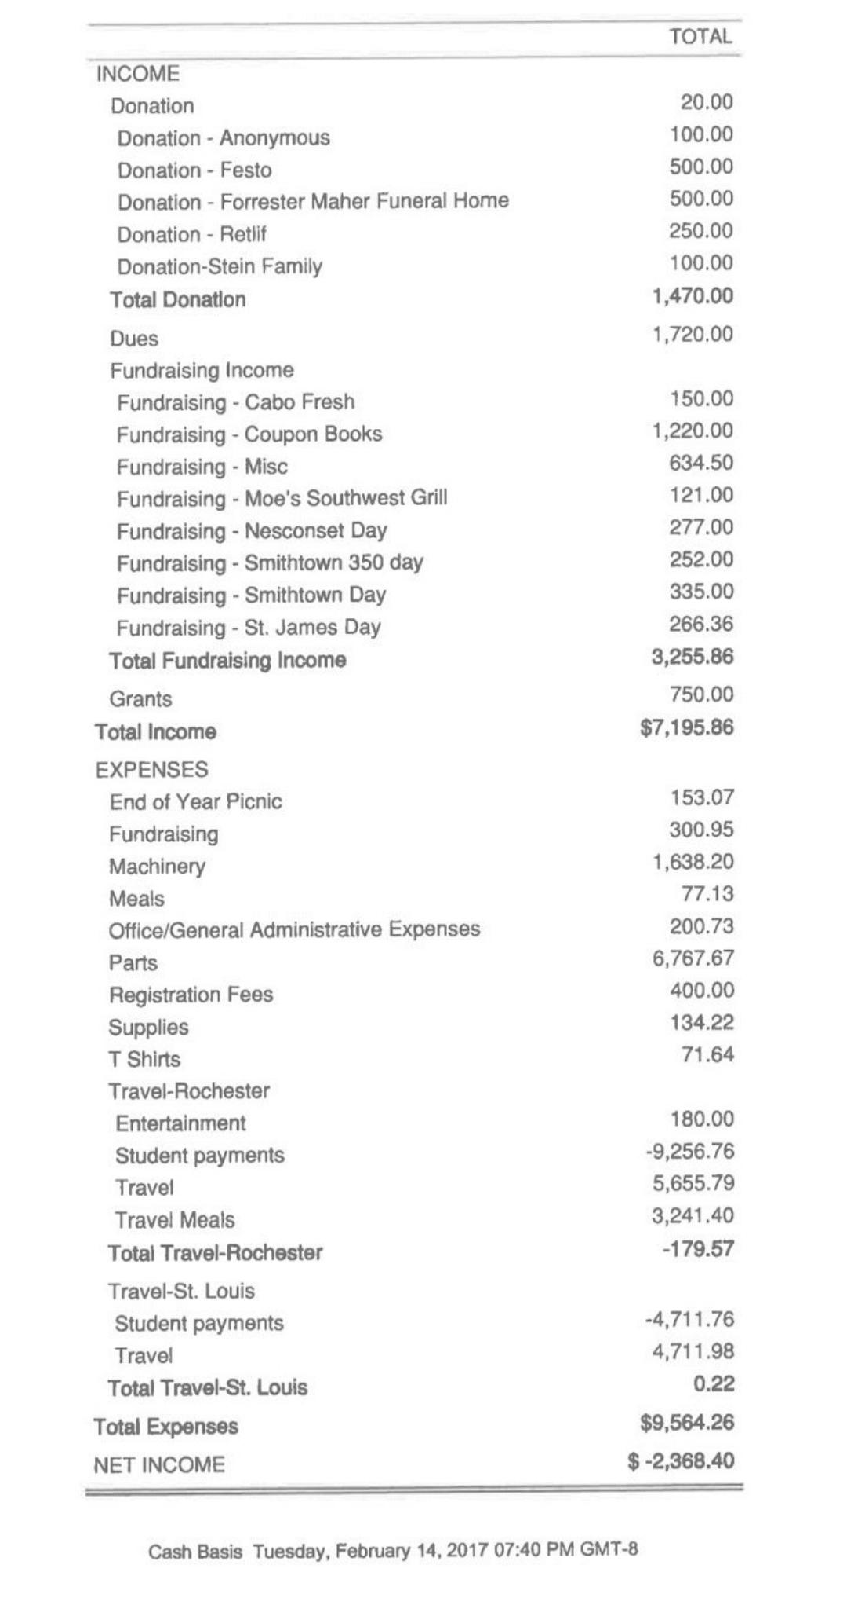
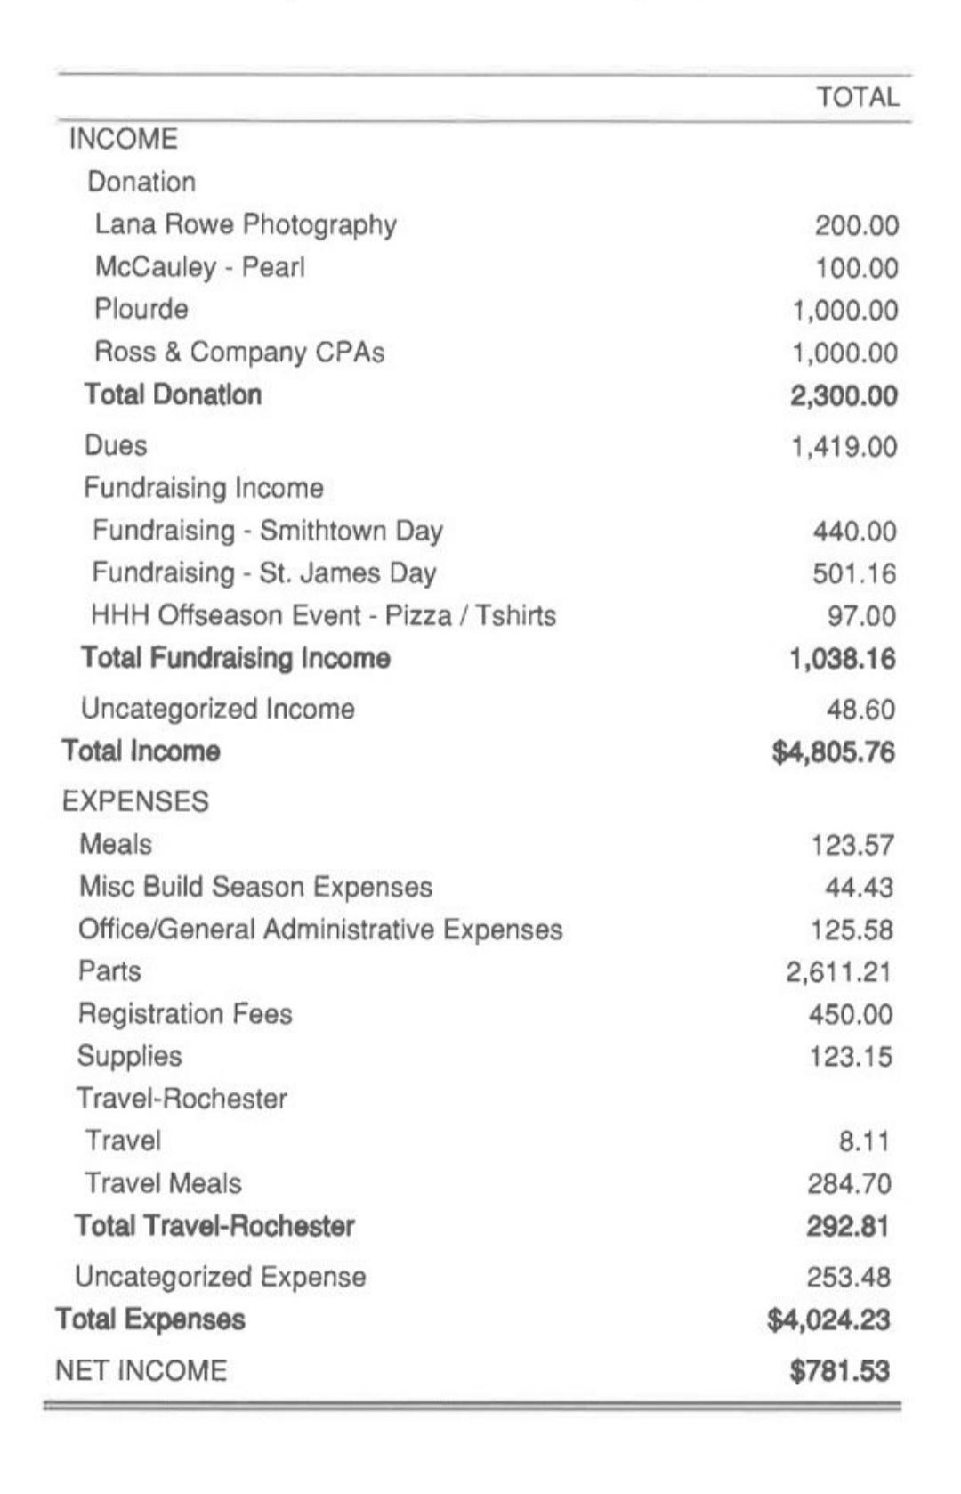

INCOME PLANS

Slide 28
PROFIT AND LOSS
Sales and Marketing
General Research and development
Other Operating costs

Slide 29
Our Services
SPREAD OF ROBOTS
MILITARY & SECURITY
CONSISTENCY
With our products we can reach far far areas of this World and help many people around the globe
Military security implies the capability of a nation-state to defend itself, and/or deter military aggression.
Our Robots can work of 24 straight with it's ultra cooling capacity and high powered processors.
AI HUMANOID ROBOTS
PRODUCT & SERVICES
FINANCIAL PLAN
People assume that humanoid robots are robots similar to human beings. This is not always the case of our humanoids robots
We offer a large variety of products to our clients with extra high stability features and own customization.
Our products are avaliable at very low cost with the help of AI we can cut our expenses in a large medium.

Slide 30
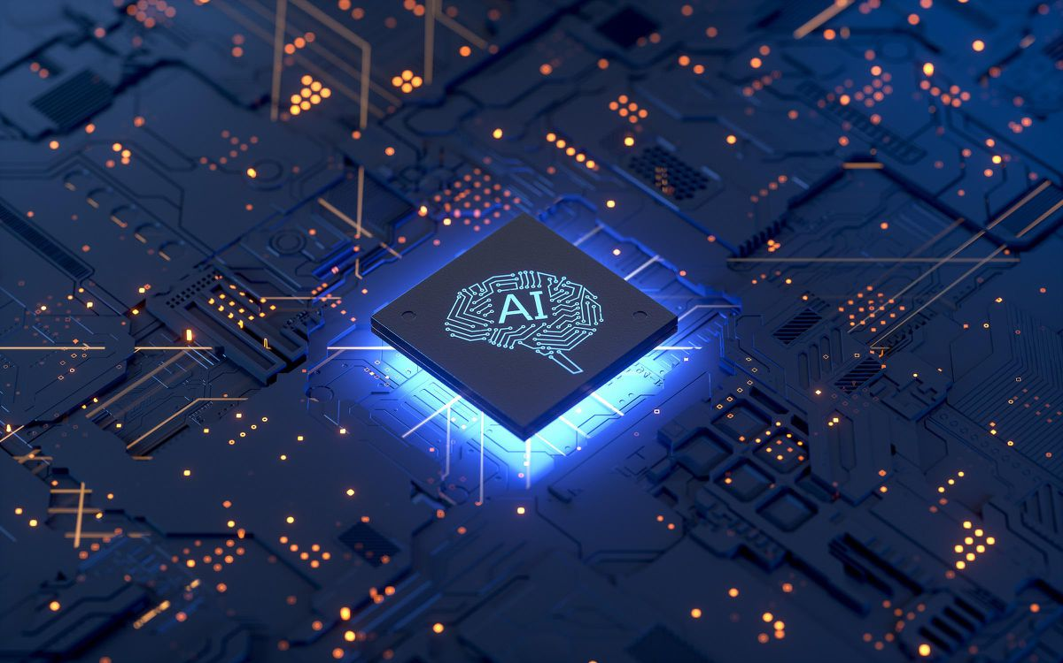
AIM for Big
Robotics and AI can help organizations perform their tasks better — and with machine learning (ML) and deep learning (an advanced form of ML using artificial neural networks), AI can become smarter over time, increasing efficiency
Every product in our company
runs with high end AI system

Slide 31
Three Laws of Robotics
A robot may not injure a human being or, through inaction, allow a human being to come to harm.
A robot must obey the orders given it by human beings except where such orders would conflict with the First Law.
A robot must protect its own existence as long as such protection does not conflict with the First or Second Law.

Slide 32
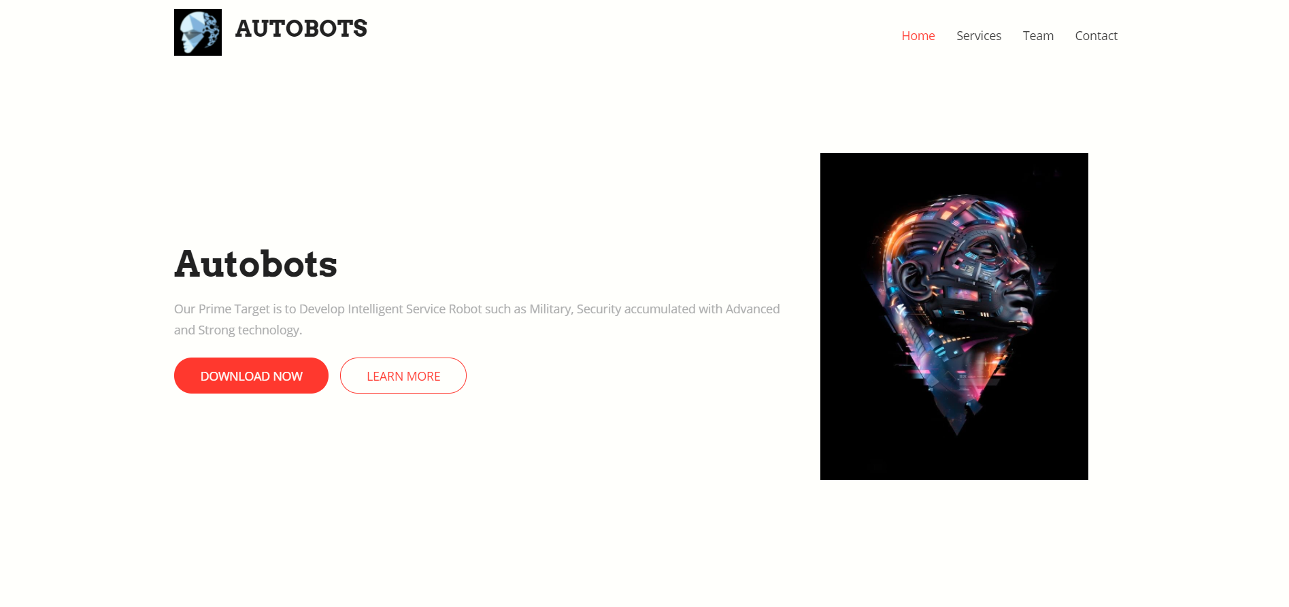
Our Website
https://theh4cker1769.github.io/autobots/

Slide 33
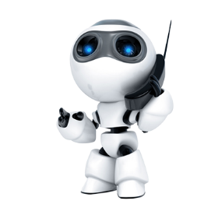
Contact Us!
Any questions?
You can find us at:
info@autobots.com &
https://theh4cker1769.github.io/autobots/

Slide 34
References
https://youtu.be/vOUVVDWdXbo
https://youtu.be/XBNwPNS9XCQ

Slide 35
THANK YOU
Adios🙃

